Slide 1
CSE 4513
Lec – 4
Requirements Engineering

Slide 2
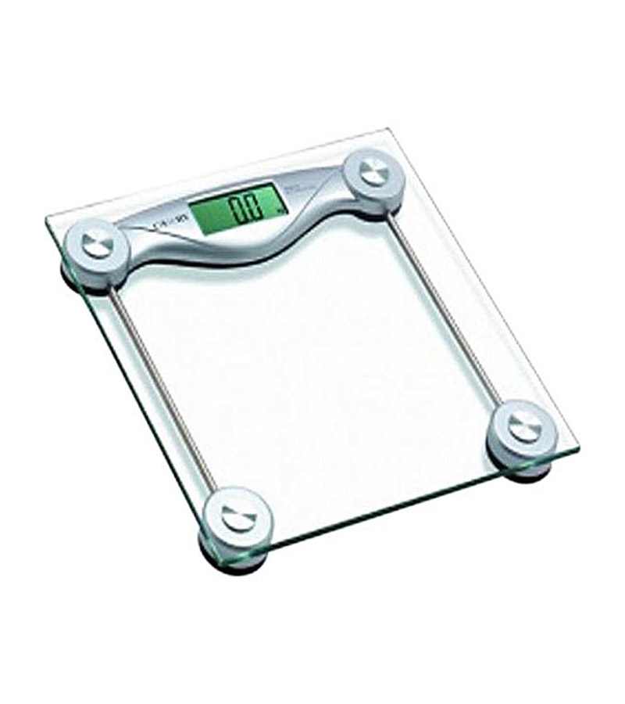
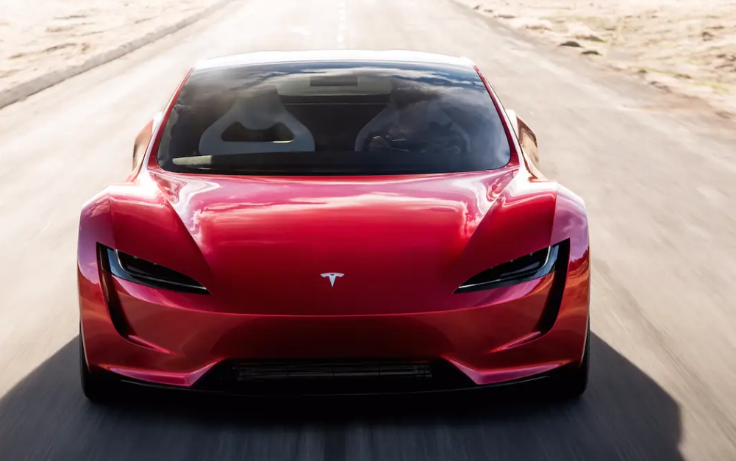
Misleading Requirements
Father: What do you want from me on your birthday?
Son: Something that moves from 0 to 60 within 3 seconds.
Father Delivered to Son
Expectation of Son

Slide 3

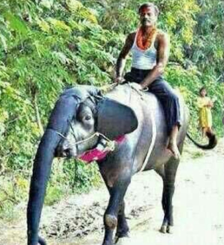

Misleading Requirements
Customer Requirements:
Have one trunk
Have four legs
Should carry load both passenger & cargo
Blackish in color
Should be herbivorous
Our Solution:
Have one trunk
Have four legs
Should carry load both passenger & cargo
Black in color
Should be herbivorous
Our Value addition: Also gives milk

Slide 4
Background..
What is a Requirement?
A condition or capability that must be possessed by a system (IEEE)
The requirements task:
Input: User needs in minds of people
Output: precise statement of what the future system will do
What is the output of the Req. phase ?
A software requirements specification (SRS) document
What is an SRS ?
A complete specification of what the proposed system should do!

Slide 5
Background..
Requirements understanding is hard
Visualizing a future system is difficult
Capability of the future system not clear, hence needs are not clear
Requirements change with time
…
It is essential to do a proper analysis and specification of requirements

Slide 6
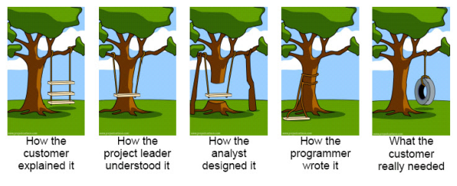
Background..
more common problems with requirements definition are :
1. Requirements do not represent the actual needs of the customer.
2. Requirements are incomplete or conflicting.
3. Requirements are difficult and expensive to update after they have been agreed upon.
4. Customers, requirements analysts, and software engineers who develop the system have difficulties understanding each other.

Slide 7
Requirement Engineering
The process of establishing the services that the customer requires from a system and the constraints under which it operates and is developed
The requirements themselves are the descriptions of the system services and constraints that are generated during the requirements engineering process.
Types of Requirements
User requirements
Statements in natural language plus diagrams of the services the system provides and its operational constraints.
Written for customers.
System requirements
A structured document setting out detailed descriptions of the system’s functions, services and operational constraints

Slide 8
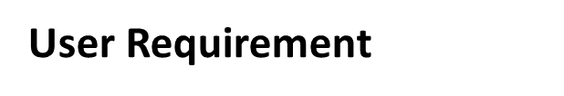
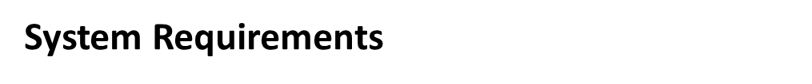
On the last working day of each month, a summary of the drugs prescribed, their cost, and the prescribing clinics shall be generated.
The system shall automatically generate the report for printing after 17.30 on the last working day of the month.
If drugs are available in different dose units (e.g., 10 mg, 20 mg) separate reports shall be created for each dose unit.

Slide 9
Functional and Non-functional requirements
Functional requirements
Describe functionality or system services.
Depend on the type of software, expected users and the type of system where the software is used.
Functional user requirements may be high-level statements of what the system should do.
Functional system requirements should describe the system services in detail.

Slide 10
Functional and Non-functional requirements
Non-functional requirements
These define system properties and constraints e.g. reliability, response time, maintainability, scalability, portability, and storage requirements.
Constraints are I/O device capability, system representations, etc.
Process requirements may also be specified mandating a particular IDE, programming language or development method.
Non-functional requirements may be more critical than functional requirements. If these are not met, the system may be useless
Non-functional requirements may affect the overall architecture of a system rather than the individual components.

Slide 11
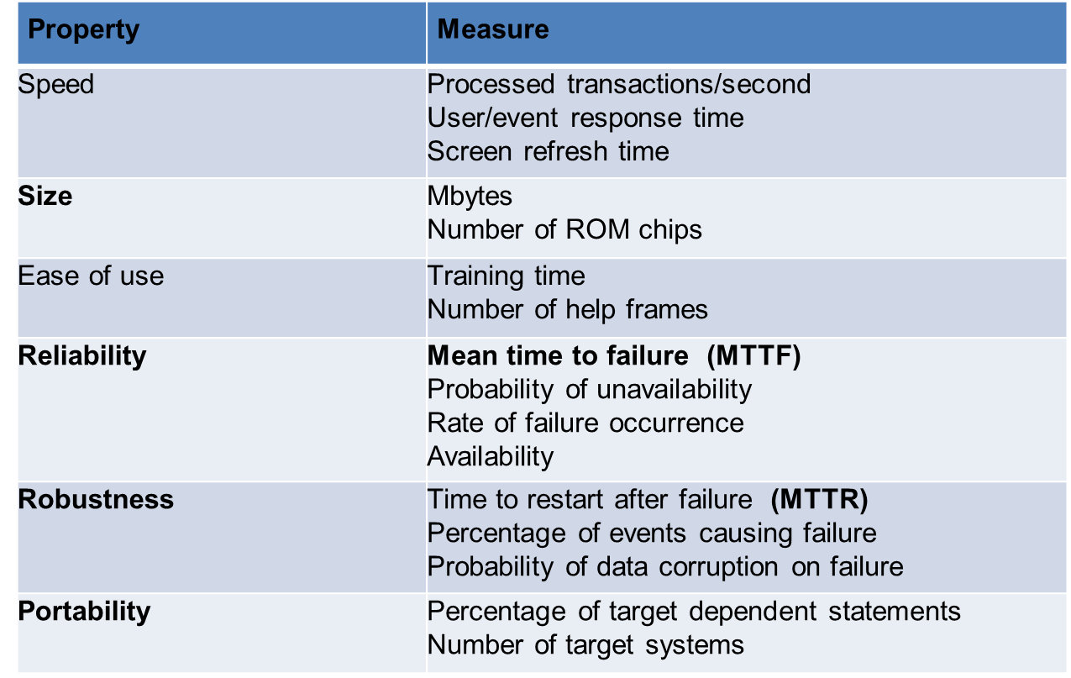
Functional and Non-functional requirements
Non-functional requirements
Metrics for specifying nonfunctional requirements

Slide 12
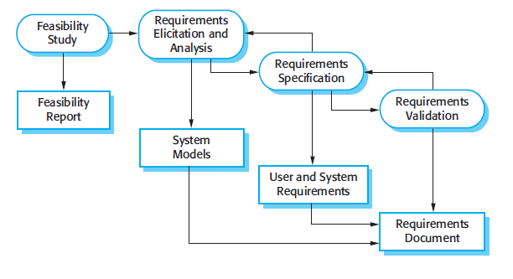
requirements engineering process

Slide 13
Problem domain
Software (Solution) domain
Describes
problem
Requirements
Specifi cation
Program
Customer
Specifies
Analyzes
Develops
We receive “customer problem statement,” not the requirements!
Software Engineer

Slide 14
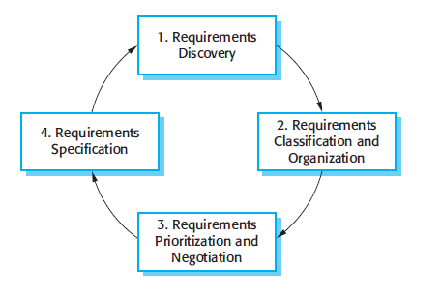
requirements engineering process
Requirements elicitation and analysis process
Requirements discovery is the process of interacting with stakeholders of the system to discover their requirements.
Requirements classification and organization takes the unstructured collection of requirements, groups related requirements, and organizes them into coherent clusters.
Requirements prioritization and negotiation takes place when multiple stakeholders are involved, requirements will conflict. This activity is concerned with prioritizing requirements and finding and resolving requirements conflicts through negotiation.
Requirements specification is the process of documenting all the requirements and input into the next round.

Slide 15
requirements engineering process
Requirements Validation
is the process of interacting with stakeholders of the system to discover their requirements.
During the requirements validation process, different types of checks should be carried out on the requirements in the requirements document.
Validity checks
Consistency checks
Completeness checks
Realism checks
Verifiability

Slide 16
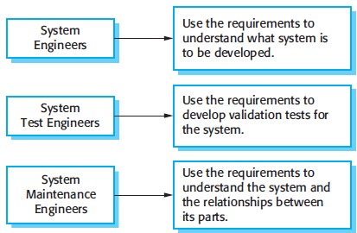
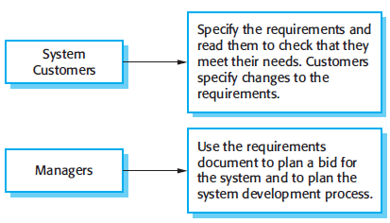
software requirements document
Called the software requirements specification or SRS
an official statement of what the system developers should implement.
include both the user requirements for a system and a detailed specification of the system requirements.
The requirements document has a diverse set of users

Slide 17
Need for SRS…
Helps user understand his needs.
users do not always know their needs
must analyze and understand the business problem
The requirement process helps clarify needs
SRS provides a reference for validation of the final product
Clear understanding about what is expected.
Validation - “ SW satisfies the SRS “

Slide 18
Need for SRS…
High quality SRS is essential for high Quality SW
Requirement errors get manifested in final SW
To satisfy the quality objective, must have high quality SRS
Requirements defects cause later problems
25% of all defects in one study; 54% of all defects found after user testing
Good SRS reduces the development cost
SRS errors are expensive to fix later
Req. changes can cost a lot (up to 40%)
Good SRS can minimize changes and errors

Slide 19
Components of an SRS
What should an SRS contain ?
Clarifying this will help ensure completeness
An SRS must specify following types of requirements:
Functional
Performance (sometime mentioned as non-functional requirement)
Design constraints
External interfaces

Slide 20
Components of an SRS
Types of Requirements
Functional
Non-functional
Specifies all the functionality that the system should support
Outputs for the given inputs and the relationship between them
All operations the system is to do
Must specify behavior for invalid inputs too
All the performance constraints on the software system
Generally on response time , throughput etc
Capacity requirements
Must be in measurable terms
Design Constraints
External Interface
Factors in the client environment that restrict the choices
Some such restrictions
Standard compliance and compatibility with other systems
Hardware Limitations
Reliability, fault tolerance, backup req.
Security
All interactions of the software with people, hardware, and sw
User interface most important
General requirements of “friendliness” should be avoided
These should also be verifiable

Slide 21
Characteristics of SRS
Correctness
Each requirement accurately represents some desired feature in the final system
Consistent
two requirements don’t contradict each other
Completeness
All desired features or characteristics are specified
Completeness and correctness strongly related
Ranked for importance/stability
Needed for prioritizing in construction
To reduce risks due to changing requirements
SRS
Characteristics
Unambiguous
Each req has exactly one meaning
Without this errors will creep in
Important as natural languages often used
Traceable
The origin of the req, and how the req relates to software elements can be determined
Verifiability
There must exist a cost effective way of checking if sw satisfies requirements

Slide 22
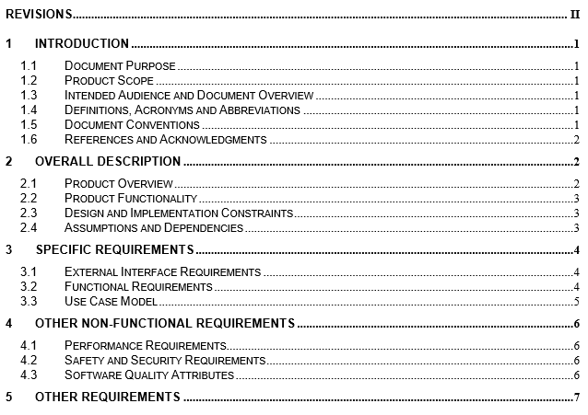

SRS Contents

Slide 23
Requirements Review
SRS reviewed by a group of people
Group: author, client, user, dev team rep.
Must include client and a user
Process – standard inspection process
Effectiveness - can catch 40-80% of req. errors

Slide 24
Requirements in Agile

Slide 25
Example: Safe Home Access
Problem detected: inconvenient physical keys or unwanted intrusion (plus: operating household devices and minimizing living expenses)
Analysis of the Causes:
User forgets to lock the door or turn off the devices
User loses the physical key
Inability to track the history of accesses
Inability to remotely operate the lock and devices
Intruder gains access
System Requirements: based on the selected causes

Slide 26
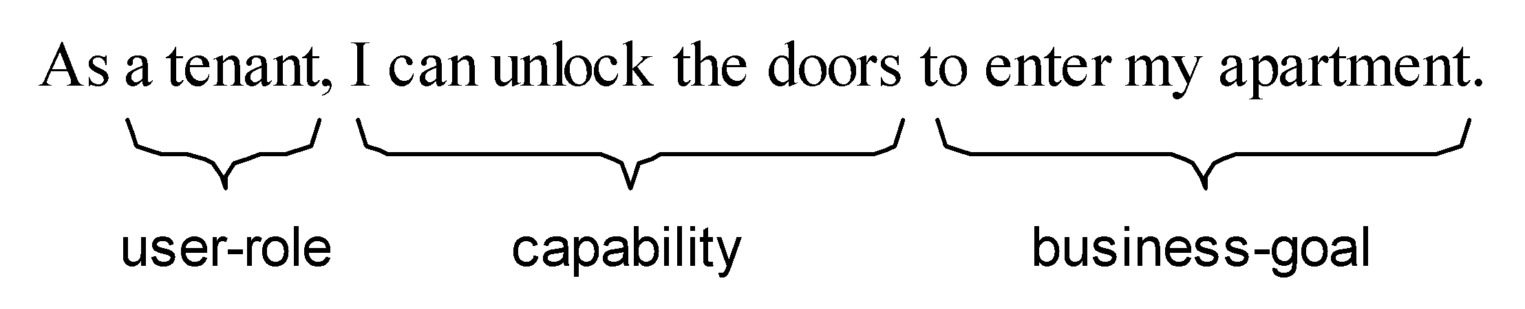
Requirements as User Stories
Preferred tool in agile methods.
Stated in terms of user’s goals and capabilities instead of system features
Written by the customer or user, not by the developer.
The development effort to implement a story is estimated immediately
Acceptance tests are written when the story is identified
Requirements identified only for the next iteration, not for the whole project

Slide 27
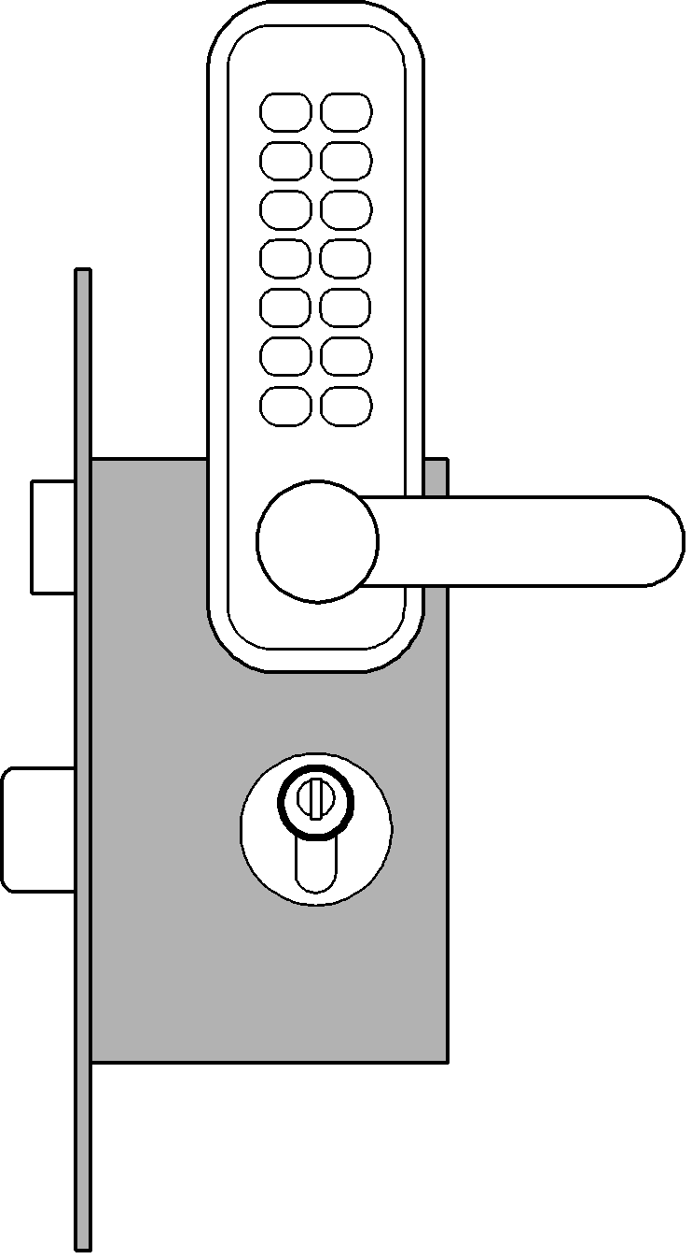
Example User Story Requirements Safe Home Access
Identifier | User Story | Size
REQ-1 | As a user, I can be sure that the doors by default will be locked. | 4 points
REQ-2 | As a user, I will be able to unlock the doors using a valid key. | 7 points
REQ-3 | An intruder will not be able to unlock the doors by guessing a valid key; the system will block when it detects a “dictionary attack.” | 7 points
REQ-4 | As a user, I can be sure that the doors will be automatically locked at all times. | 6 pts
REQ-5 | The door keypad will be backlit when dark for visibility. | 3 pts
REQ-6 | Anyone will be able to lock the doors on demand. | 3 pts
REQ-7 | As a user, I will be able to manage additional user accounts. | 10 pts
REQ-8 | As a user, I will be able to view the history of accesses to my home. | 6 pts
REQ-9 | As a user, I will be able to configure the preferences for how my household devices will be activated on my arrival. | 6 pts
Note no priorities for user stories
Story priority is given by its order of appearance on the to-do list

Slide 28
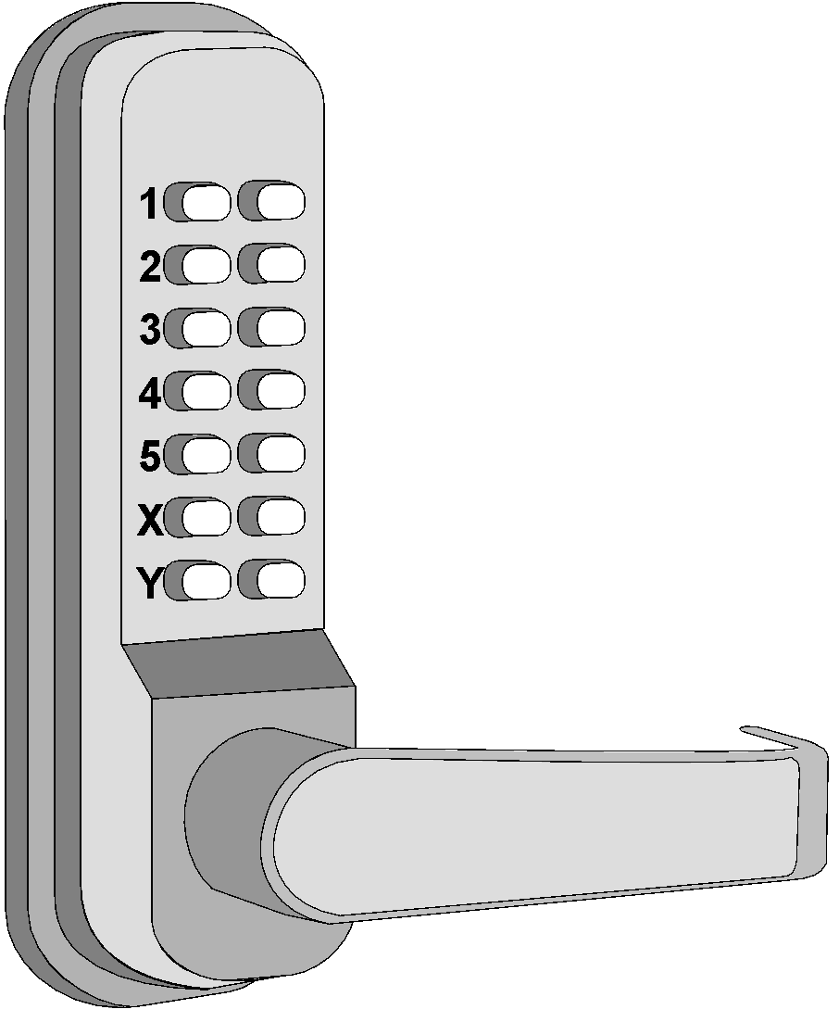
Problem Domain:How Electronic Lock Works
We may need separate descriptions/models of door vs. lock.
Door state is what the user cares about; lock is one way of achieving it.
Computer
Lock
Voltage:
HIGH
Physical domain (lock) description; used in specification
LOW
lock armed
lock disarmed
lock armed
Semantic meaning defined by user’s goals; used in requirements
The behavior of the system-to-be determined not only by user’s actions but also by the context (“situation”).
E.g., what in case of power failure?
- By default armed
- By default disarmed (e.g., fire exit)

Slide 29
Analyst’s Task: Three Descriptions
Concern:
can the entered number have more digits than a valid keycode?
If yes, which digits are considered?
What if the user attempted using invalid keys and gave up before reaching the limit?
Can the automatic locking be disabled if needed?
What if the door is not shut when the lock is being armed?
The requirement
The problem domain
What user wants:
When valid keycode entered & Unlock pressed, open the lock;
Automatically lock after a period of time.
The specification
How problem domain behaves:
What software-to-be will do (at interface):
If entered number matches one of stored numbers & Button-1 pressed, put HIGH voltage on Output-port-1;
Start a timer countdown;
When the timer expires, put LOW voltage on Output-port-1.
Armed
Electromechanical lock
HIGH VOLTAGE /
LOW VOLTAGE /
Disarmed
Concern:
It is not obvious that this is the only or even “correct” solution to the requirement-posed problem.

Slide 30
Acceptance Tests
Means of assessing that the project success criteria
The requirements are met as expected
An acceptance test describes whether the system will pass or fail the test, given specific input values
But we cannot ever guarantee 100% coverage of all usage scenarios
Each requirement describes for a given “situation” (i.e., system inputs), the output or behavior the system will produce. The “output” represents the user’s need or business goal
An acceptance test specifies a set of scenarios for determining whether the (part of the) system meets the customer requirements
An acceptance test case specifies, for a given “situation” or “context” (defined by current system inputs), the output or behavior the system will produce in response

Slide 31
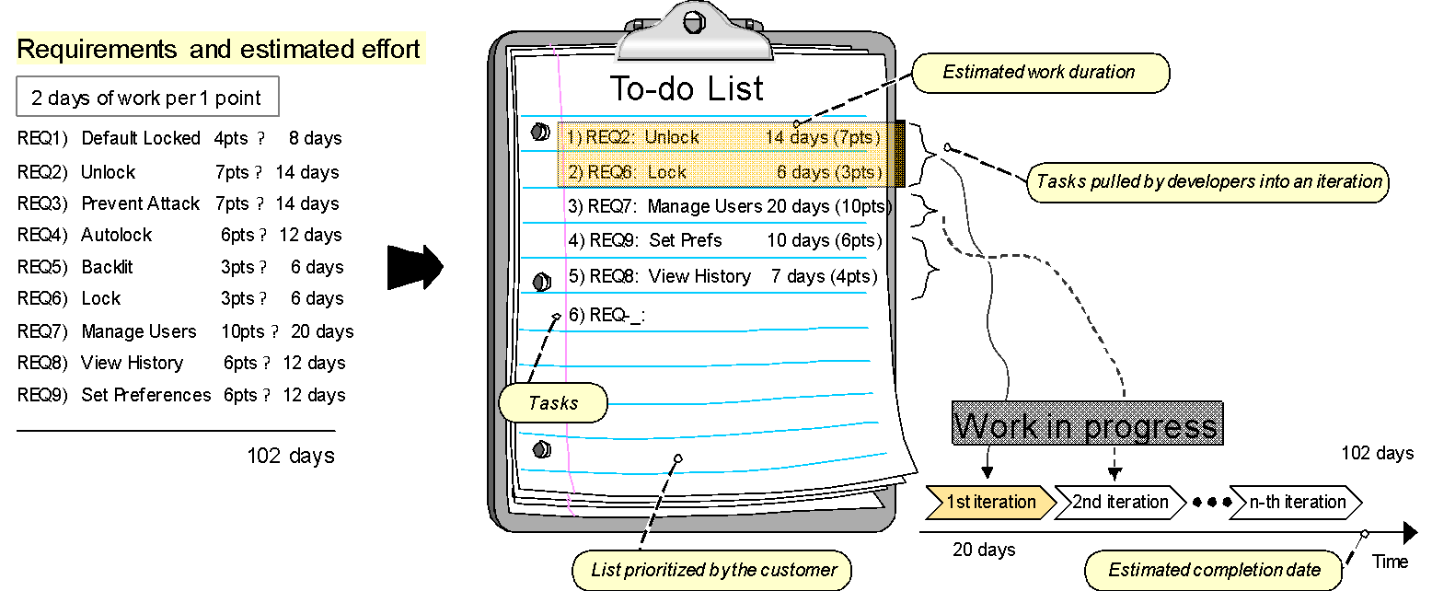
Agile Estimation of Project Effort
Instead of assigning priorities, the customer creates an ordered list of user stories 🡺 TO-DO LIST
Developers simply remove the top list items and work on them in the next iteration 🡺 IN-PROGRESS LIST

Slide 32
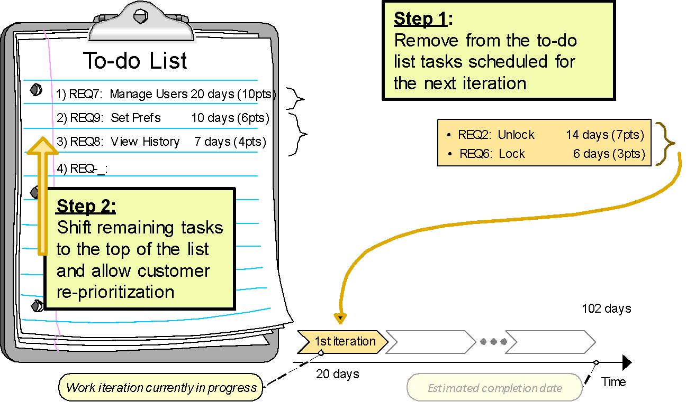
Tradeoff between Customer Flexibility and Developer Stability
Items pulled by developers into an iteration are not subject to further customer prioritization
Developers have a steady goal until the end of the current iteration
Customer has flexibility to change priorities in response to changing market forces

Slide 33
Next Class
User interface Design

